Slide 1
Do Now
Pick up notes for today
Get out your notes from last time
Sit Quietly In A Desk
→NO ONE IS TO SIT ON COUCHES!
*Reminder… Cell phones/ ipods/ ipads are not allowed in class
Agenda
Notes!
Catch Up!!

Slide 2
SECTION 3: THE HOME FRONT
The war provided a lift to the U.S. economy
Jobs were abundant and despite rationing and shortages, people had money to spend
By the end of the war, America was the world’s dominant economic and military power

Slide 3
Betty Grable: Allied Pinup Girl
She Reminded Men What They Were Fighting For ;)

Slide 4
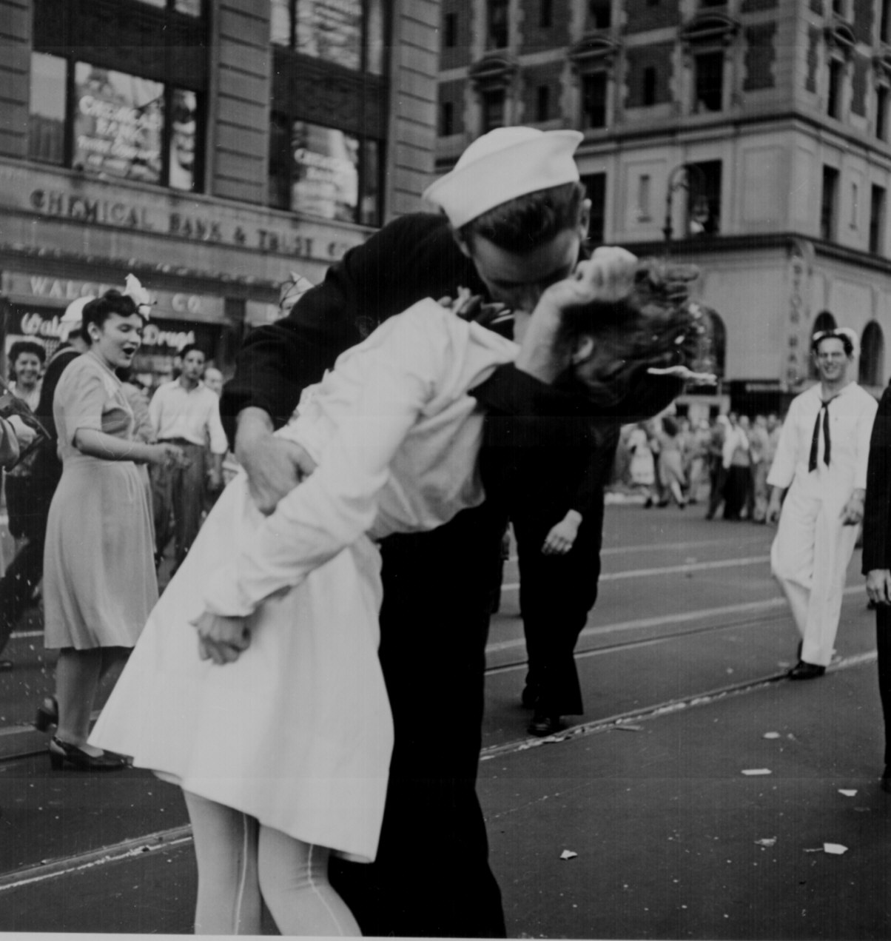
Famous picture of an American soldier celebrating the end of the war

Slide 5
FDR DIES; TRUMAN PRESIDENT
President Roosevelt did not live to see V-E Day
On April 12, 1945, he suffered a stroke and died– his VP Harry S Truman became the nation’s 33rd president

Slide 6
THE YALTA CONFERENCE
In February 1945, as the Allies pushed toward victory in Europe, an ailing FDR met with Churchill and Stalin at the Black Sea resort of Yalta in the USSR
A series of compromises were worked out concerning postwar Europe
(L to R) Churchill, FDR and Stalin at Yalta

Slide 7
YALTA AGREEMENTS
1) They agreed to divide Germany into 4 occupied zones after the war
2) Stalin agreed to free elections in Eastern Europe
3) Stalin agreed to help the U.S. in the war against Japan and to join the United Nations

Slide 8
NUREMBERG WAR TRIALS
Herman Goering, Hitler's right-hand man and chief architect of the German war effort, testifies at his trial. He was found guilty of war crimes but avoided execution by swallowing potassium cyanide.
The discovery of Hitler’s death camps led the Allies to put 24 surviving Nazi leaders on trial for crimes against humanity, crimes against the peace, and war crimes
The trials were held in Nuremberg, Germany
“I was only following orders” was not an acceptable defense as 12 of the 24 were sentenced to death and the others to life in prison

Slide 9
ECONOMIC GAINS
Unemployment fell to only 1.2% by 1944 and wages rose 35%
Farmers too benefited as production doubled and income tripled

Slide 10
WOMEN MAKE GAINS
Women enjoyed economic gains during the war, although many lost their jobs after the war
Over 6 million women entered the work force for the first time
Over 1/3 were in the defense industry

Slide 11
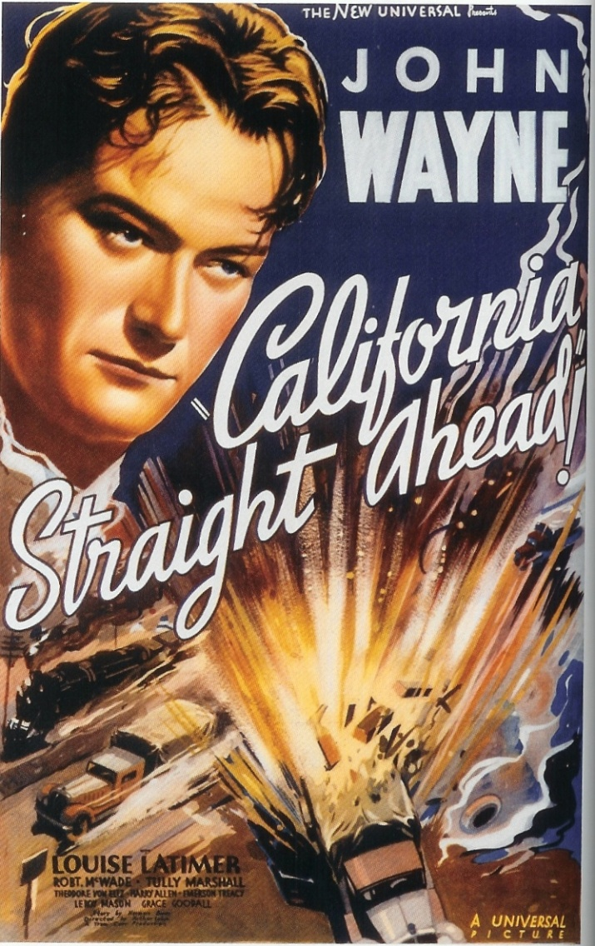
POPULATION SHIFTS
The war triggered the greatest mass migration in American history
More than a million newcomers poured into California between 1941-1944
African Americans again shifted from south to north

Slide 12
GI BILL HELPS RETURNING VETS
To help returning servicemen ease back into civilian life, Congress passed the Servicemen’s Readjustment Act (GI Bill of Rights)
The act provided education for 7.8 million vets

Slide 13
INTERNMENT OF JAPANESE AMERICANS
When the war began, 120,000 Japanese Americans lived in the U.S. – mostly on the West Coast
After Pearl Harbor, many people were suspicious of possible spy activity by Japanese Americans
In 1942, FDR ordered Japanese Americans into 10 relocation centers
Japanese Americans felt the sting of discrimination during WWII

Slide 14
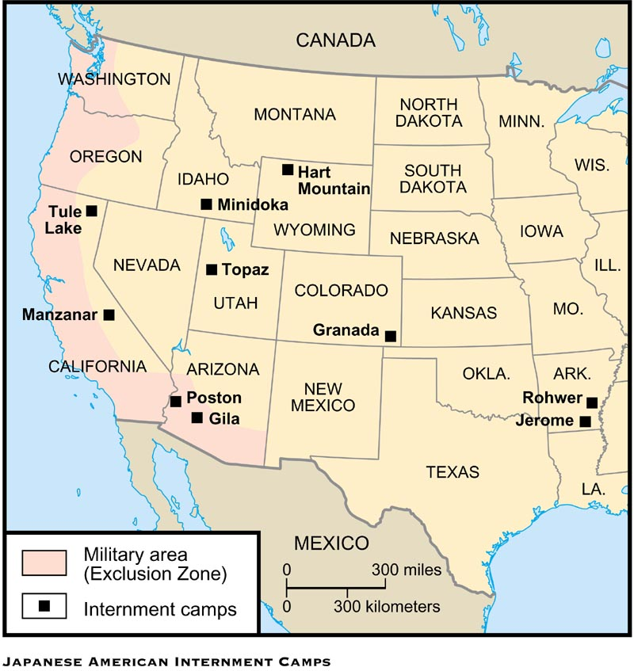
Location of the 10 Internment camps

Slide 15
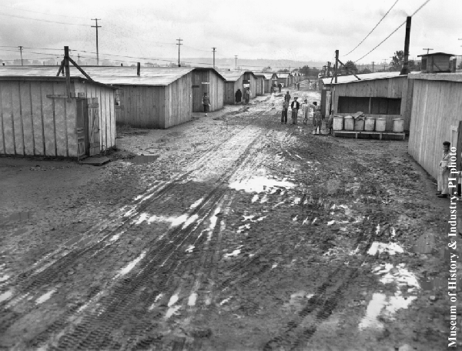
Jerome camp in Arkansas

Slide 16
U.S. PAYS REPARATIONS TO JAPANESE
In the late 1980s, President Reagan signed into law a bill that provided $20,000 to every Japanese American sent to a relocation camp
The checks were sent out in 1990 along with a note from President Bush saying, “We can never fully right the wrongs of the past . . . we now recognize that serious wrongs were done to Japanese Americans during WWII.”
Today the U.S. is home to more than 1,000,000 Japanese-Americans

Slide 17
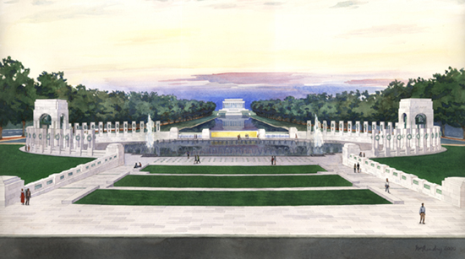
Nearly 59 years after the end of World War II, the National World War II Memorial was dedicated in Washington, D.C., on Saturday, May 29, 2004 to honor the 408,680 Americans who died in the conflict

