Slide 1
Do Now
Grab your notes!
Write the title of your slides on your notes!
Agenda
Do Now
Notes!
The Pacific

Slide 2
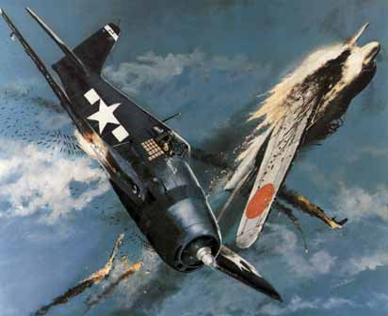
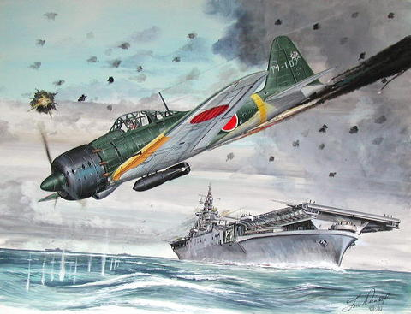
The War in the Pacific
World War II

Slide 3
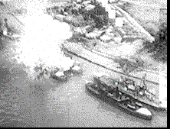
After the shock of the Pearl Harbor attack, American forces in the Pacific needed several months to regroup.
Explosion of the Arizona

Slide 4
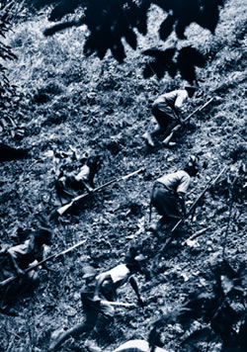
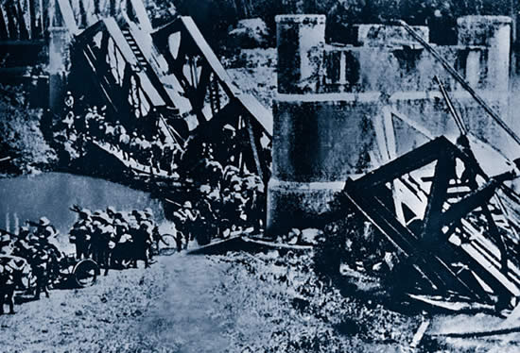
During this time, Japan went after the region’s natural resources, including oil and rubber.
Japanese troops in Burma.
Japanese soldiers in
Singapore.

Slide 5
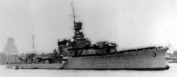
By the end of March 1942, the Japanese had captured British Hong Kong and Singapore, the American islands of Guam and Wake, and the oil-rich Dutch East Indies.
Japanese Cruiser Yubari

Slide 6
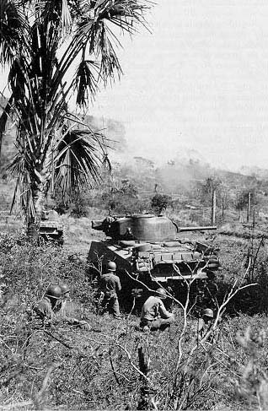
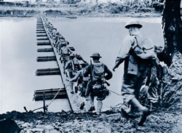
In the Philippines, Americans and Filipinos under U.S. General Douglas MacArthur resisted a fierce Japanese campaign.
U.S. troops preparing for the Japanese
invasion of the Philippine Islands.

Slide 7
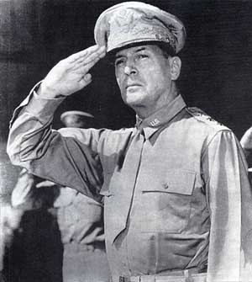
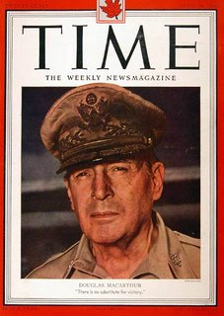
In March, Roosevelt ordered General MacArthur to leave the islands. Upon his departure, the general promised,
“I shall return.”

Slide 8
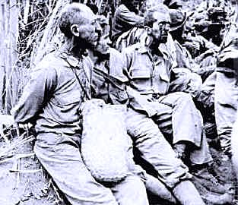
Two months later, Japan completed its conquest of the Philippines.

Slide 9
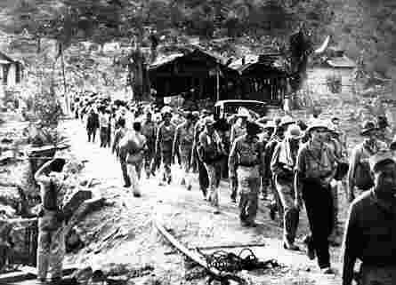
The Japanese rounded up 70,000 starving, exhausted American and Filipino prisoners and marched them up the Bataan Peninsula near Manila to a prison camp.

Slide 10
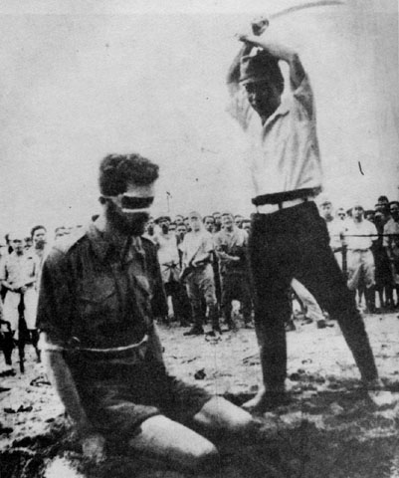
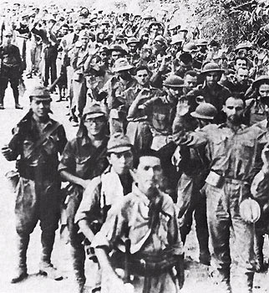
During the brutal 63-mile march, Japanese soldiers beat and bayoneted many of the prisoners. More than 7,000 died on the infamous Bataan Death March.

Slide 11
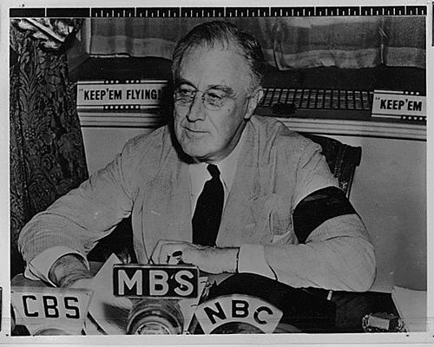
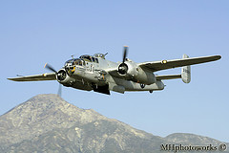
To boost morale, President Franklin Roosevelt urged his military to strike directly at the Japanese home islands. They came up with a plan to fly B-25 bombers off an aircraft carrier.

Slide 12
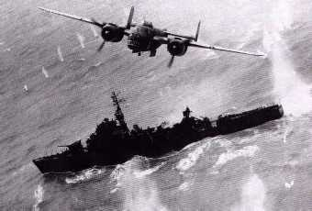
The B-25 could make a short takeoff and also had the range to reach Japan and then land at Allied airfields in China.
A B-25 dropping a 5,000 pound bomb on a
Japanese frigate.

Slide 13
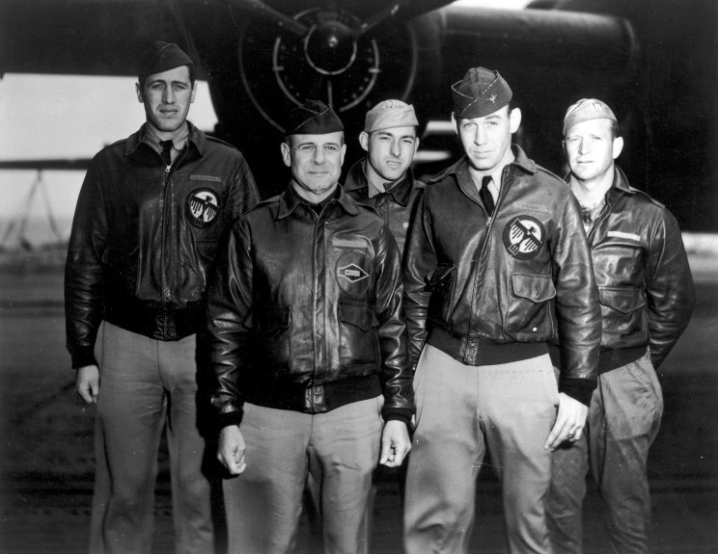
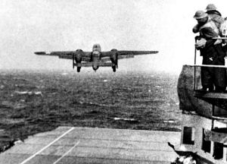
Doolittle Raid
On April 18,1942, 16 bombers took off from the carrier Hornet, which sailed to within 650 miles of Japan. Led by pilot Lieutenant Colonel James Doolittle, the bombers hit Tokyo and other Japanese cities.
Doolittle Raiders

Slide 14
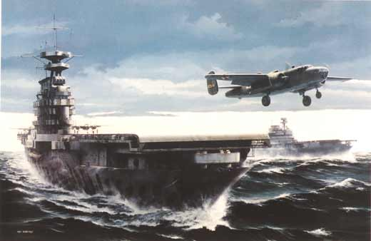
Doolittle Raid on Tokyo

Slide 15
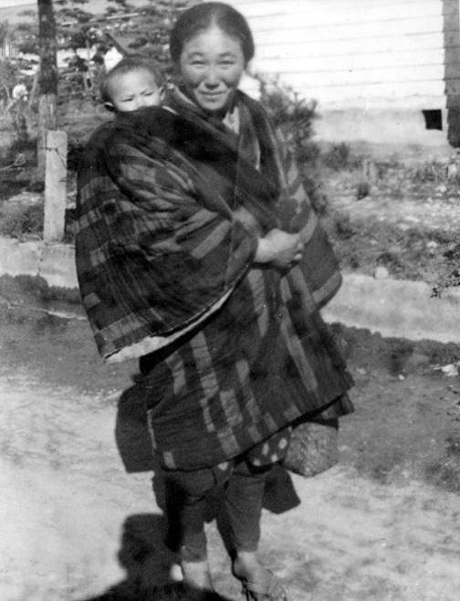
Although the bombs did little damage, this surprise attack shocked the Japanese.

Slide 16
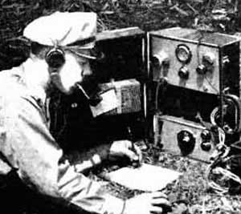
During Doolittle’s raid, American code breakers got news of enemy activity in the Coral Sea. Japan was moving into position to attack Australia, a key American ally.

Slide 17
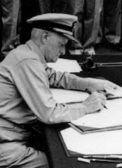
To stop the Japanese, U.S. Admiral Chester Nimitz sent two aircraft carriers, several cruisers, and a few destroyers to intercept. They would face a larger Japanese force that included three carriers.
Texan born –
Admiral Chester Nimitz,
U.S. Naval Commander
of the Pacific.

Slide 18
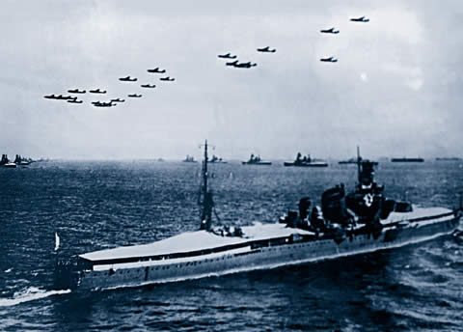
The resulting Battle of the Coral Sea, in early May 1942, was fought entirely by carrier-based aircraft.
Japanese navy assembling for battle in the Coral Sea.

Slide 19
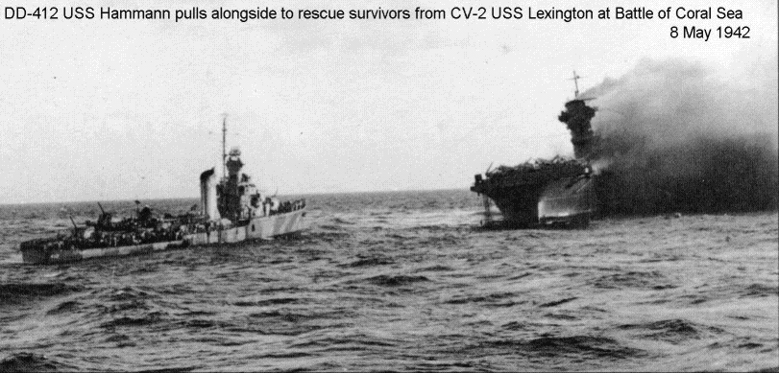
Japanese aircraft sank the carrier Lexington and damaged the Yorktown. American pilots sank one Japanese carrier and damaged the other two.
Lexington aflame.

Slide 20
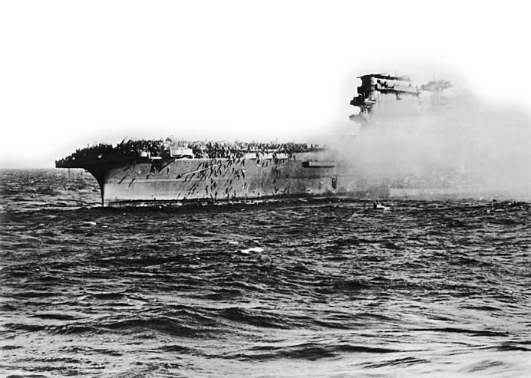
Navy sailors jumping off the burning carrier Lexington.

Slide 21
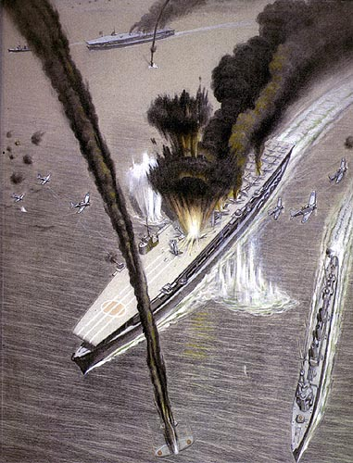
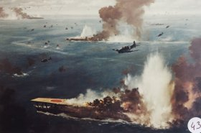
Despite fairly even losses, the Americans gained a strategic victory. They blocked Japanese expansion to the south.

Slide 22
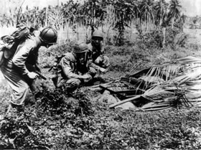
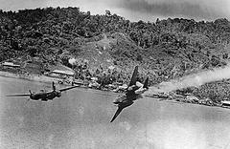
When the Americans went on the offensive, they chose a strategy of liberating Japanese-held islands in the Pacific and using them as stepping stones. Each captured island served as a base for assaults on other islands.
Bombs Away !

Slide 23
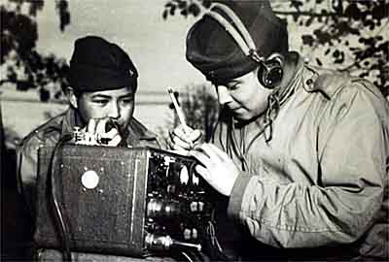
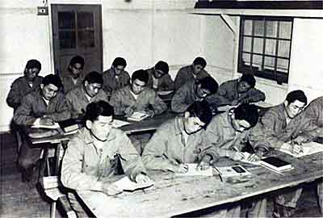
Wind Talkers
One of the keys to Allied success in the Pacific was the use of secret codes. The United States trained a special group of Navajo Indian “code talkers” for the task.

Slide 24
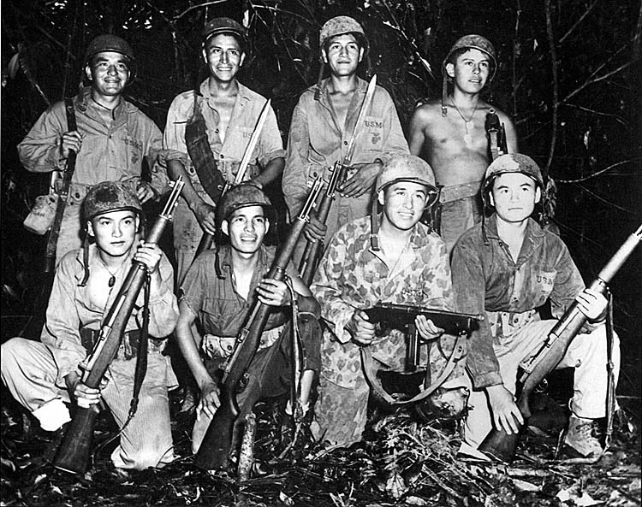
Because Navajo is not a written language and is understood by very few people, it made an excellent basis for a code to transmit vital information.

Slide 25
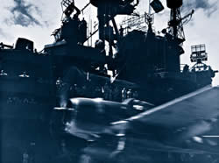
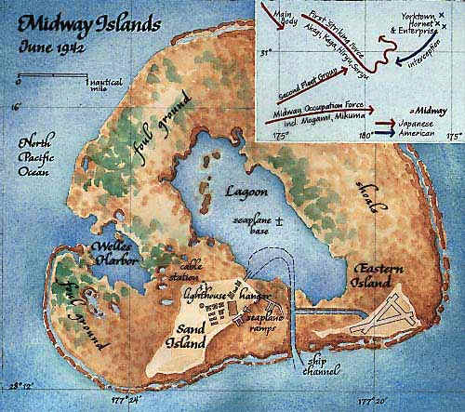
Before the Allies could go on the offensive, they had to stop Japanese expansion. They achieved this goal at the Battle of Midway, in June 1942.
An American Hellcat

Slide 26
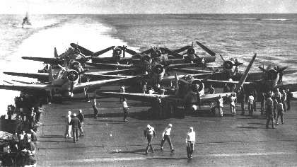
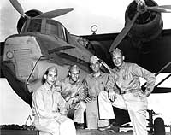
The Americans intercepted a Japanese message telling of plans for a major attack. They figured out that the target was the U.S. base at Midway, a pair of islands about 1,200 miles northwest of Pearl Harbor. With this knowledge, the navy set a trap for the Japanese fleet.
Fighter planes await on the deck of the
aircraft carrier Enterprise.

Slide 27
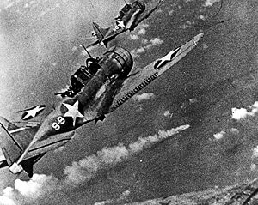
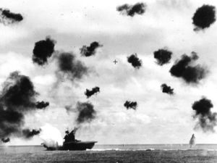
American planes from Midway and from three aircraft carriers demolished the Japanese force, destroying all four Japanese carriers, a cruiser, and about 300 aircraft.

Slide 28
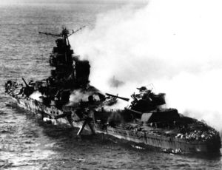
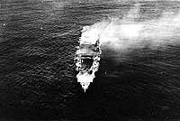
Japan never recovered from the loss of the carriers and so many experienced pilots. From then on, Japan would focus on defense.
Japanese carrier Hiryu on flames.

Slide 29
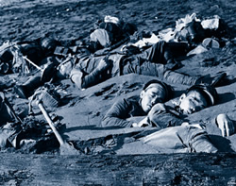
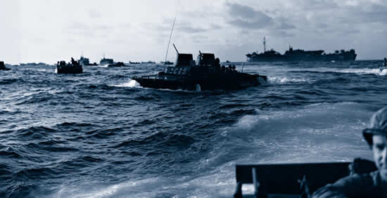
A strategy known as leapfrogging. They would often leapfrog, or bypass, a heavily defended island and then capture a nearby island that was not well defended.
Dead Japanese troops along
a riverbed in Guadalcanal.

Slide 30
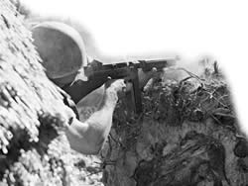
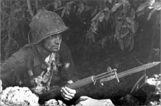
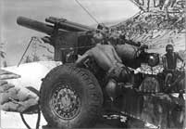
Despite the success of leapfrogging, many of the island invasions came at a terrible cost. Thousands of soldiers died in the jungles of the Pacific Islands.
American soldier firing on a
Japanese position.

Slide 31
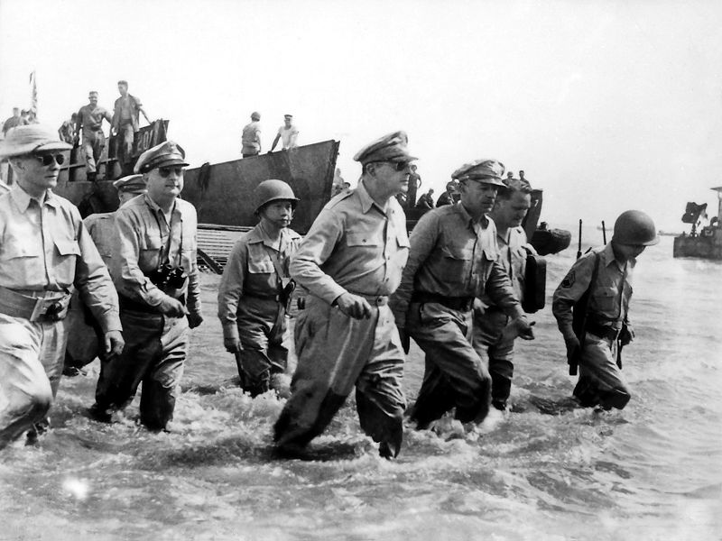
In October 1944, MacArthur made a triumphant return to the Philippines and Marianas Islands, where his forces would battle the Japanese.

Slide 32
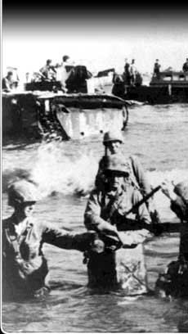
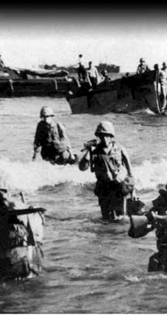
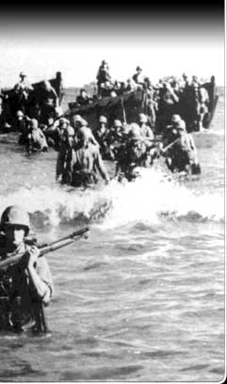
The Marianas victory gave the Allied Pacific force secure bases from which long-range B-29s could make bombing raids on Japan.

Slide 33
On the small volcanic island of Iwo Jima, the Japanese dug caves, tunnels, and concrete bunkers. Three months of Allied bombardment did little to soften the Japanese positions.

Slide 34
The month-long Battle of Iwo Jima was among the bloodiest of the war. Nearly all of the 22,000 Japanese troops followed their commander’s orders to “fight to the death.” More than 6,800 American troops died.

Slide 35
Early in the Pacific War, the Japanese had introduced a new weapon – kamikaze pilots. Hundreds of men flew their bomb-filled planes directly into the vessels of the Allied Fleet.
Kamikaze Pilot
Bunker Hill burning after being struck
by two Kamikaze pilots.

Slide 36
The stage was now set for an invasion of Japan. But the United States had scientists working on another option. Scientists of the Manhattan Project, had carried out research on developing the world’s first atomic bomb.

Slide 37
The Manhattan Project resulted in the creation of the first nuclear weapon, and the first-ever nuclear detonation, known as the Trinity test on July 16, 1945 in New Mexico.
Trinity explosion

Slide 38
After Iwo Jima and Okinawa, President Truman knew an invasion of Japan would produce enormous casualties. The number of Allies killed and wounded might reach half a million.
“Fat Man”

Slide 39
Truman had to decide whether to drop the atomic bomb on Japan or to launch an invasion of Japan.

Slide 40
The Japanese seemed ready to fight to the last man, woman, and child, in the spirit of the kamikaze. Many believed only the shock of an atomic bomb would end the Japanese resistance.
Kamikaze pilot receiving
A cheerful farewell by young
Japanese girls.

Slide 41
On August 6, 1945, a B-29 named the Enola Gay dropped an atomic bomb on Hiroshima, Japan, a city of 300,000 people. Within seconds of the explosion, up to 80,000 people died.

Slide 42
Three days later, the U.S. dropped a second atomic bomb. This bomb destroyed the city of Nagasaki, killing 40,000 people instantly.

Slide 43
As many as 250,000 Japanese may have died from the two atomic bombs, either directly or as the result of burns, radiation poisoning, or cancer.

Slide 44
The destruction of Nagasaki brought a Japanese surrender. Truman received this informal surrender on August 14, Victory over Japan Day (V-J Day). The terms of the surrender allowed the emperor to keep his office but only in a ceremonial role.

Slide 45
The Allies officially accepted the Japanese surrender aboard the American battleship Missouri in Tokyo Bay on September 2, 1945.

Slide 46
About 55 million died (30 million civilians) during World War II. The Soviet Union paid the highest human cost, with more than 20 million of its people killed. Some 400,000 Americans gave their lives.

