Slide 1
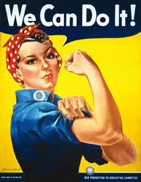
ABC… It’s “Easy” As 1,2,3?
FDR’s New Deal Program (4-7)
- The New Deal (4-5)
- Court packing controversy (7)
American Isolationism and American Strength (8)
Isolationism
American fear of communism
Neutral But Not (9)
North Atlantic Charter
Land-Lease Act
Destroyers for Military Bases Deal
Across The Pond (3, 10)
World wide depression
German and Italian responses (Hitler and Mussolini)

Slide 2
The Least You Need To Know
The ______________________________ was the first blow to America’s economy
Because of this and ________________________________ America was in serious ______________
We entered the _________________________________
Although the _______________________ was a condition caused by the environment, it also was a metaphor for America
People had no ______________ and therefore could not afford anything, even the necessities like food and shelter
President ___________________ was blamed for the current economic situation, and the shanty towns people had to set up were called _______________________
With so much to worry about at home, America remained ________________________ from the rest of the world
Things did not look good.
Notes:
Stock market crash
Borrowing on credit, debt
Great depression
Dust bowl
Money
Hoover, hoovervilles
isolated

Slide 3
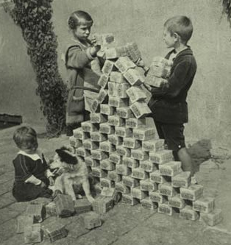
Across the Pond…
Americans were starving, jobless and feeling the Great Depression
But depression wasn’t limited to America ➔The entire world was feeling the hurt…
Remember the treaty of Versailles?
Fascism vs. Communism
vs. Democracy
Totalitarianism=
Inflation=

Slide 4
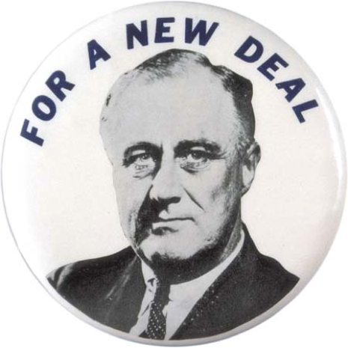
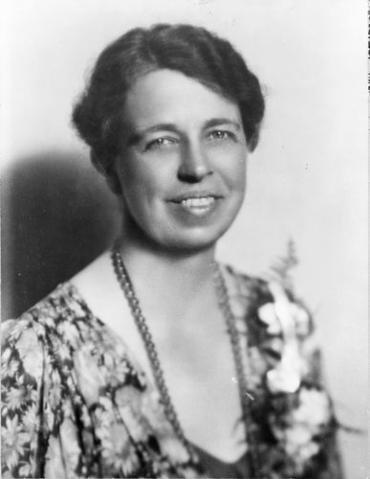
The Roosevelt’s
Harvard and Columbia grad
Appointed as the secretary of the Navy under Wilson
Had polio➔
“I pledge you, I pledge myself, to a New Deal for the American people”
“A good society is able to face schemes and plans of world domination and foreign revolutions alike without fear”
Redefined First Lady
Furthered feminism
Visible figure to America
“Great minds discuss ideas; Average minds discuss events; Small minds discuss people”

Slide 5
New Deal Policies & Programs (1933-1938)
Roosevelt’s platform for recovery
Federally funded, federally administered program of relief→ (4 goals…)
1. promised to stimulate industrial recovery
2. Aid victims of the Great Depression
(something Hoover, and no other president had done!)
3. Guarantee minimum living conditions
4. Avoid future crises
In FDRs “First 100 Days,” he had legislation passed to provide relief
New Democrats➔
STOP AND THINK→ Why would a same party congress be good, bad?

Slide 6
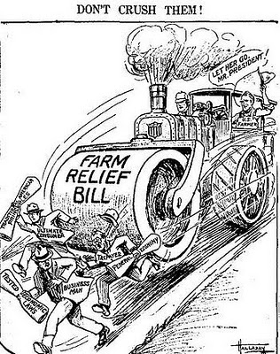
Government Redefined
New Deal Programs
- Federal Insurance Cooperation (FDIC)
- Federal Securities Act (FSA)
- Civilian Conservation Corps (CCC)
- National Recovery Act (NRA) ➔ Public Works Administration (PWA) ➔ Works Progress Administration (WPA)
Agricultural Adjustment Administration (AAA) ➔ Tennessee Valley Authority
Manhattan Project=
Social Security=

Slide 7
1 Step Forward, 2 Steps Back?
Wagner Act (1935)
→ Employees shall have the right of self-organization, to form, join, or assist labor organizations (unions), to bargain collectively through representatives of their own choosing, and to engage in concerted activities, for the purpose of collective bargaining or other mutual aid or protection. → HELLO, RIGHT TO WORK
→ It shall be an unfair labor practice for an employer-To interfere with, restrain, or coerce employees in the exercise of the rights guaranteed in section
STOP AND THINK- What does the Wagner Act Represent?
West Coast Hotel v Parrish (1937)
→ In 1932, Washington State passed a law entitled "Minimum Wages for Women." (It called for minimum wages for women and children)
→ Elsie Parrish, a chambermaid at the West Coast Hotel, later sued the hotel in a state court claiming that it had not paid her the law's minimum wages
→ ULTIMATELY the Court held that the minimum wage law was constitutional because it reasonably regulated contracts to protect the health and welfare of workers
STOP AND THINK- What does the land mark case West Coast Hotel v Parrish represent?
Court Packing Controversy (1937)
→ FDR pack the courts with Judges that would always rule in his favor aka rule The New Deal constitutional
STOP AND THINK → Was the New Deal, (and…FDR’s practices for that matter,) Constitutional?

Slide 8
American Isolationism During the 1930s
Remember Monroe?
Isolationism=
STOP AND THINK→ what would we be pre-occupied with?
Neutrality Acts (1935-1937)
Series of laws that provided Americans could not ship weapons, loan money, travel on belligerent ships, extend credit, or deliver goods to any belligerent countries; they were high tide of isolationism, and all were repealed between 1939 to 1941. ➔
STOP AND THINK→ Why could this be problematic? (HINT- think cause and effect!)
America Realizing its Strength
America realizes world peace means America cannot stay neutral, but its going to take something explosive to break our isolationism
Women and minorities are realizing their strength as well… more job opportunities

Slide 9
Neutral… But Not
America was all about what? ➔
But….
North Atlantic Charter= Made by US and Great Britain (they hoped Russia would join) defined post WWII goals ➔ Collective Security… So neutral or not?
→ STOP AND THINK= Why would we want Russia to join?
“Destroyers-for- military- bases deal” = traded land with Great Britain so America could gain control of more land throughout the world.. And by land= military bases…. So neutral or not?
Lend- Lease Act- Allowed the president to aid allied nations- for “American safety” ….. So neutral or not?
→STOP AND THINK= Was America really neutral?

Slide 10
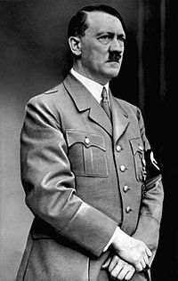
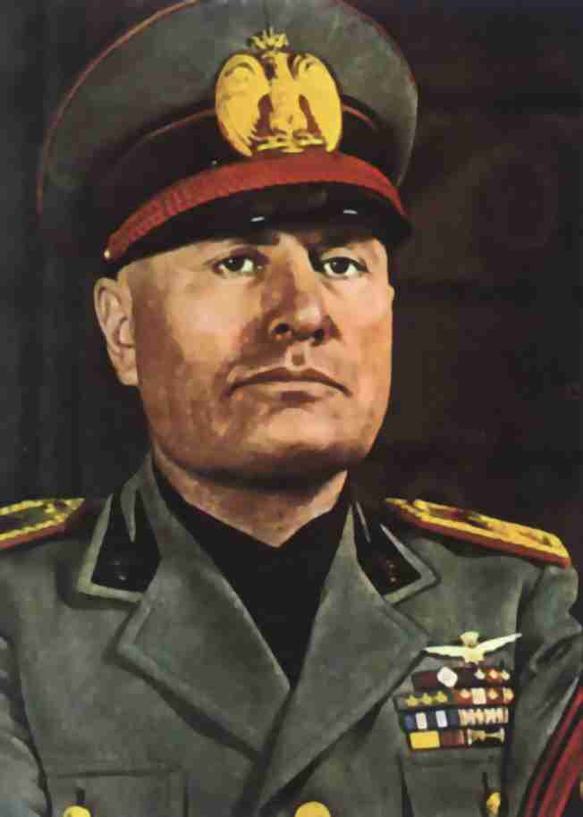
Military Actions of Mussolini and Hitler
Adolf Hitler
Rejected painter
Ruled ALL of Germany- Internal strife not tolerated
Leader of the Nazi Party… More to come!
Targeted homosexuals, disabled people, Jews and anyone who was NOT a Nazi supporter= NO EQUALITY
Militaristic Authority= Dictator= Their Way, Or NO WAY!
Benito Mussolini
Journalist with, “Big Ideas,” promised Italians a better tomorrow
Fascist= _____________________________
STOP AND THINK→ Why would people listen?

Slide 11
The Least You Need To Know
Although _____________________ is often blamed for the ______________________...
It was really the American people _________ _____________ that lead to the collapse of the __________
_________ attempted to “re-animate the economy,” with the _________________- which redefined the role of _____
The __________________ left Germany crippled, and _________________ was out of control!
The warring ideologies of ________________, ____________________ and ________________ represented the major players of what will turn into WWII
_______________ ruled Germany, _______________ ruled Italy and ___________ ruled America→Strength of president INCREASING!
Get ready for __________________________
Notes:
Hoover, great depression
Borrowing on credit, economy
FDR, New Deal, gov
Treaty of Versailles, inflation
Communism, fascism, democracy
Hitler, Mussolini, FDR

Slide 12
Exit Slip Separate Sheet of Paper (as per usu)
1. Was the New Deal Constitutional? → this should be your opinion, use evidence! (3pts)
2. Why was America embracing isolationism? (2pts)
3. Why were democratic countries threatened by totalitarianism? Why were they tempted? (3pts)

Slide 13
bbonline1.ips.k12.in.us
Password= clock

