Slide 1
Can I have a Dollar??
Life In The Great Depression

Slide 2
The Least You Need To Know…
1. If drinking, when drinking- when drinking was illegal (_________________) was one them of the 1920s, the other was _________________
2. ________________________ was when you only paid for part of what you bought.
3. The ____________________ class was especially drawn to the idea of borrowing on credit, because they wanted to feel ________
4. Inventions like the _________________ car- which most Americans owned, gave people a sense of luxury.
5. Yet with all that borrowing, it meant that most Americans were in _____________________
6. On October 29th, 1929 the _______________ crashed.
7. Leaving most American, and America as a whole _____________________ ➔ no one could pay back what they owed…. Including the ____________ and __________
8. This was the beginning of the _______________________.

Slide 3
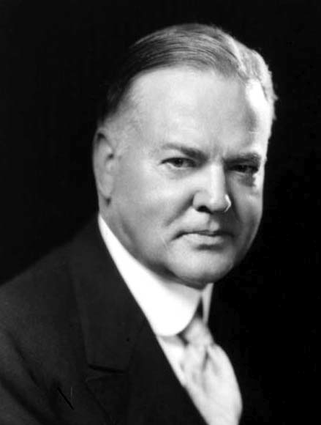
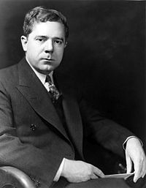
Social Reformers
___________________Herbert Hoover
Senator Huey Long_________________

Slide 4
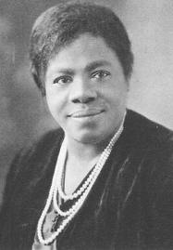
Mary McLeod Bethune

Slide 5
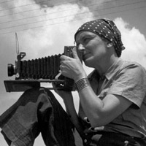
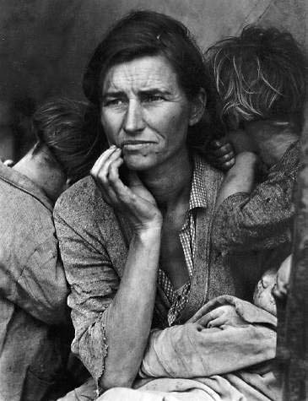
Dorothea Lange_________

Slide 6
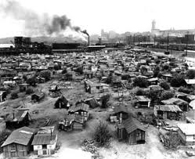
Breadlines and Hoovervilles

Slide 7
Describe Technological Developments During the 1920s And Their Impact On Rural and Urban America.

Slide 8
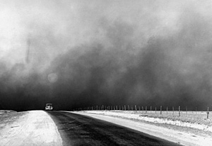
Dust Bowl

Slide 9
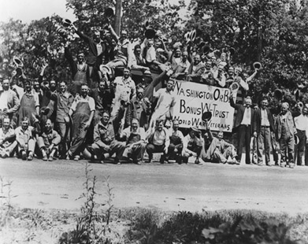
Bonus Army Marches (1932)

Slide 10
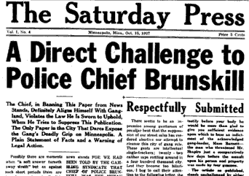
Smoot-Hawley Tariff
Near v. Minnesota (1931)
dfgdfg

Slide 11
The Least You Need to Know…

Slide 12
Exit Slip Separate Sheet of Paper
1. How did we end up in this great depression?
2. How did Who was the most important social reformer, why?
3. How desperate were people?
4. What was the dust bowl? Why is it a metaphor for the time?

